Slide 1



Introducttion
GROUP-5:
Nguyễn Thanh Duy
Võ Thiên Vũ
Nguyễn Phan Hoài Nam
Nguyễn Đức Trí

Slide 2



Campus Security Staffs Management System

Slide 3




GROUP PROJECT INTRODUCTION
The objective of the Campus Security Staffs Management System is to automate and streamline the management of security staff duties, leave requests, and salary calculations for University A, reducing manual workload and ensuring efficient coverage of all campus locations.

Slide 4
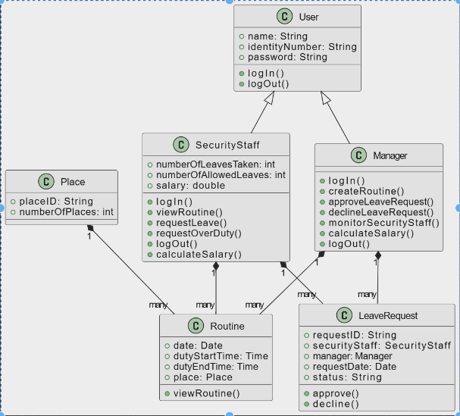


Class Diagram

Slide 5


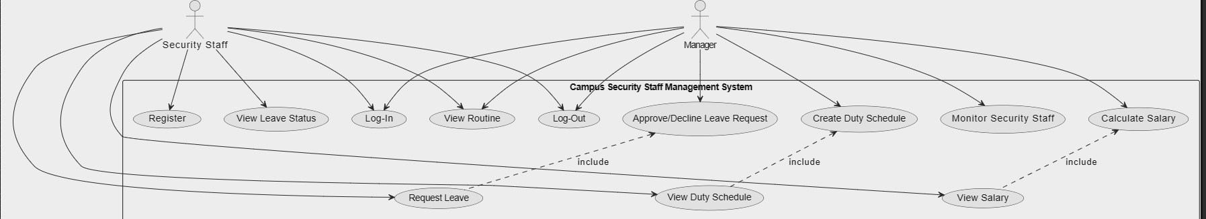


Use Case Diagram

Slide 6



Security Staff Functionalities:
Log-In and Log-Out
View duty schedule for upcoming 7 days
Request leave or over duties
View number of leaves taken and remaining
View salary at the end of the month

Slide 7






Log-In and Log-Out
Create routine for upcoming 7 days for all security staff considering leave requests.
Approve/decline leave requests.
Monitor security staff status.
Manager Functionalities
View salary at the end of the month

Slide 8



Non-functional requirements considered:
Security: The system must ensure secure login and authentication for all users.
Performance: The system must be able to handle a large number of users and transactions efficiently.
Usability: The system must be user-friendly and easy to navigate for both security staff and manager.
Scalability: The system must be able to adapt to changes in the number of security staff and campus locations.

Slide 9







Programming Languages, Software Tools, databases
Programming Languages: Java , Html , Css & JavaScript
Software Tools: Visual Studio Code
Databases : PhpMyAdmin (MySQL)

Slide 10


Software Architecture
The system follows a three-tier architecture:
Presentation Layer
Business Logic Layer
Data Access Layer
This architecture ensures separation of concerns, making the system more maintainable and scalable.

Slide 11


Detailed Execution of Functionalities
Security Staff Log-In and View Schedule | The security staff enters their username and password to log in. The system verifies the credentials and displays the upcoming 7-day schedule. The schedule includes the date, duty start time, duty end time, and place.
Request Leave or Over Duty | The security staff submits a leave or over duty request to the manager. The manager receives the request and can approve or decline it. The system updates the security staff's schedule accordingly.

Slide 12
Detailed Execution of Functionalities
Manager Creates Routine | The manager creates a routine for all security personnel, considering leave requests. The system ensures that all places are covered by at least one security person. The routine is displayed to the security staff.
Salary Calculation | The system calculates the salary of each security personnel at the end of the month. The calculation considers the number of leaves taken and the fixed amount deducted as fine. The salary is displayed to the security staff.

Slide 13

Thank
you!

